Slide 1

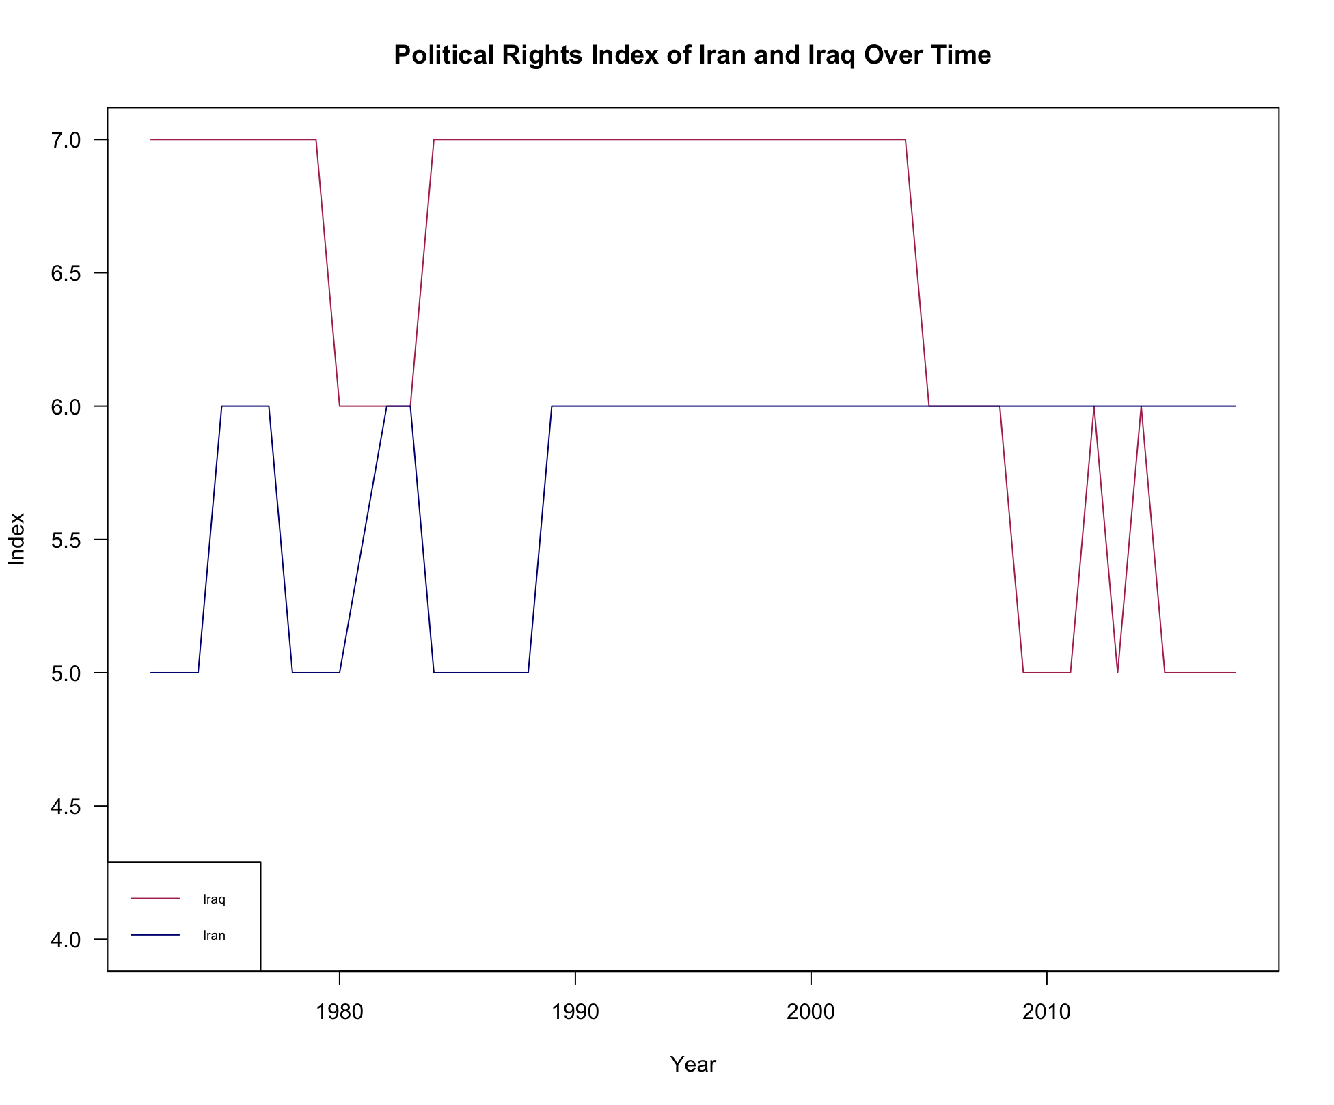
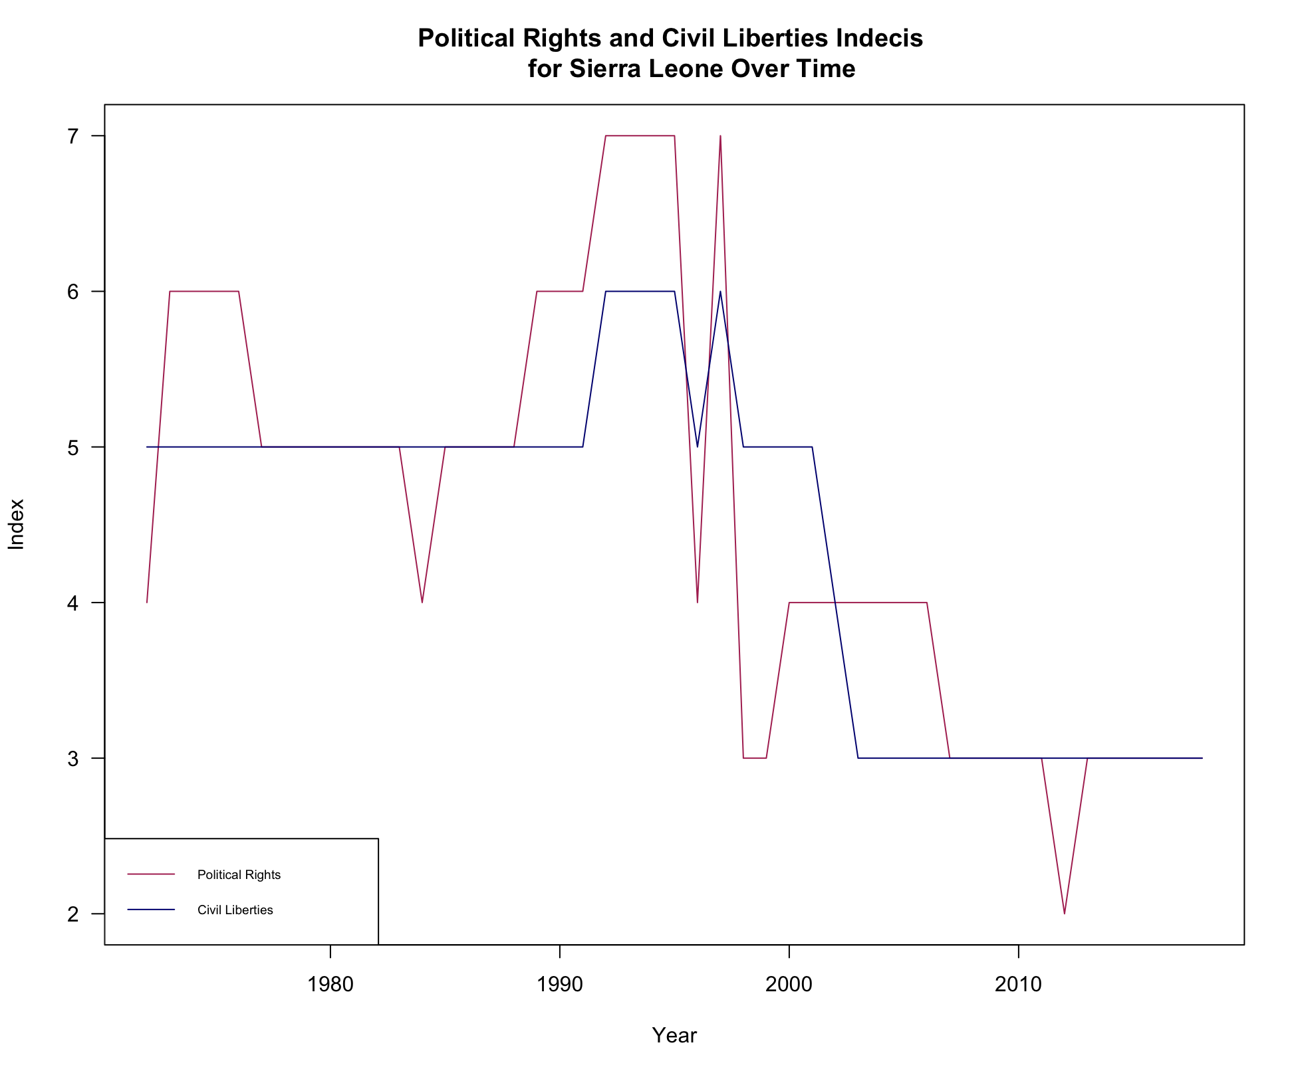
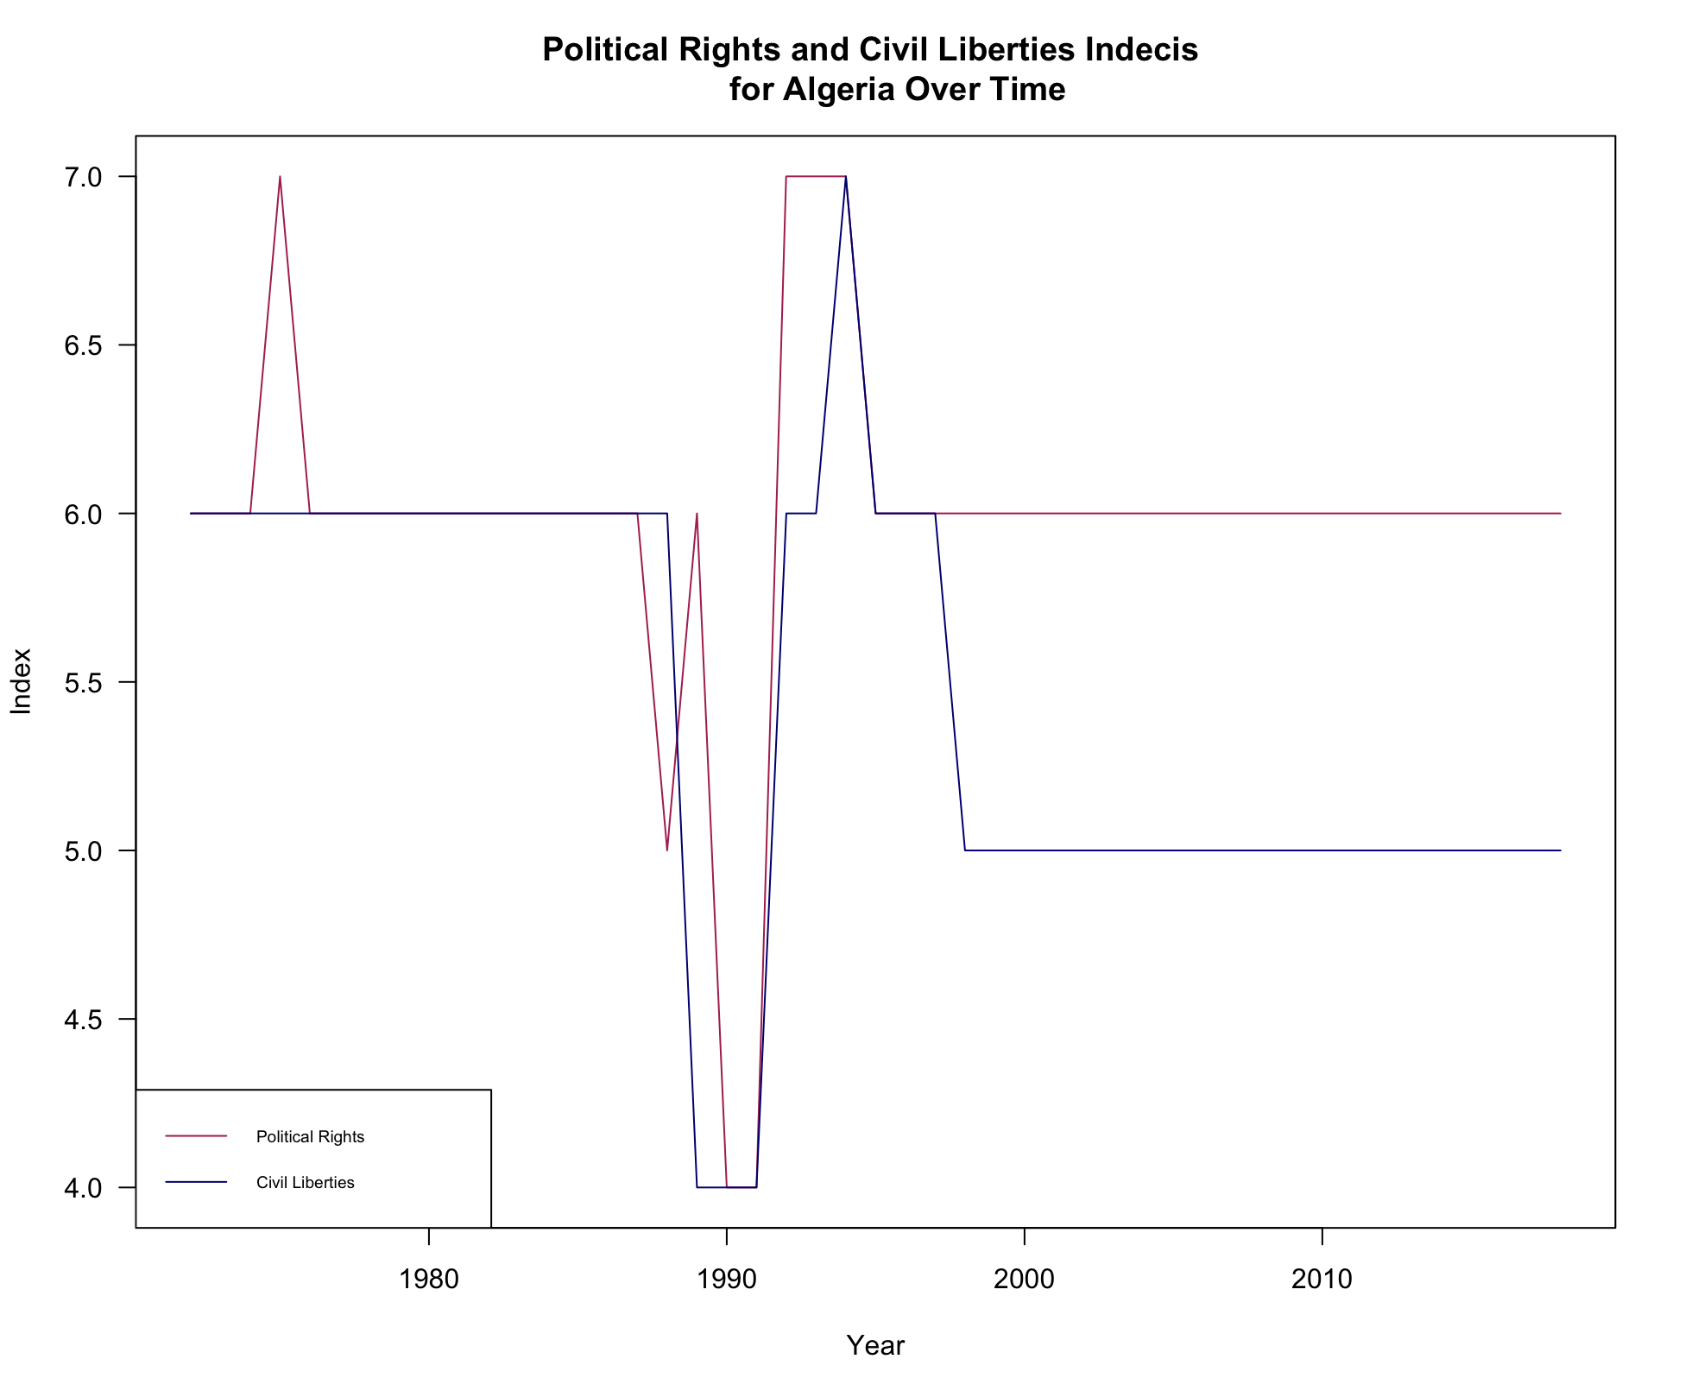
Data Science for Political Science
Effects of War on Political Rights and Civil Liberties
Sameer Ali
DATA AND METHODS
ABSTRACT
[COULD DESCRIBE HOW VARIABLES ARE CODED HERE]
KEY RESULTS
The United States has time and time again shown that during times of War, the Federal Government is more than glad to restrict our Civil Liberties and/or Political Rights. I wanted to see if this was something unique to the US, or if other countries did the same thing. My research lead me to the conclusion that while there was some difference, that difference was not statistically different enough to warrant a causal claim, that other countries did the same thing that the US does.
DATA
My data described each country or territory in a given year, the variable it was measuring (Political Rights or Civil Liberties), and the score (from 1-7)
My data has 17418 rows, each representing a territory / country during a certain year (starting from 1970s, 1980s, or 1990s, depending on the country)
APPROACH
I subsetted the data for every country I was looking at (Sierra Leone, Algeria, Iraq, and Iran), then further subsetted it to times of war/not of war, then again for the two different variables
I plotted the all the trends of Political Rights / Civil Liberties in the Countries. For Iran and Iraq, I plotted Political Rights and Civil Liberties separately.
I then did a t-test between the averages of the Indices in war time vs not in war time for all the countries
In order to see if there was a true statistical difference in the averages of Political Rights during Wartime and After, I conducted a t-test at a 95% confidence level for every single country; following are the p-values found for every country
Sierra Leone: 0.05385
Algeria: 0.113
Iraq and Iran: 0.3656, and 0.004, respectively.
Except for Iran, all p-values were greater than 5%, which indicated that the difference found was not statistically significant.
BACKGROUND
Research Question. Do other countries besides the United States also restrict Political Rights and / or Civil Liberties of their people during times of when they are in War?
Importance. Historically, the United States has decided that National Security was more important than the Rights granted to us by the Constitution. I wanted to analyze and see if this sentiment was something unique to the United States, or it was a trend that one can see abroad as well. This research could provide interesting insights into the attitudes of United States Citizens and how that may differ with people living in other countries.
Background.
Freedom in the World is an organization that conducts an annual survey with the goal of scoring a country on a scale from 1-7 on 1. The level of Political Rights they enjoy, and 2. The level of Civil Liberties they enjoy.
7 indicates Complete Restriction, whereas 1 indicates Complete Freedom
The Methodology to the questions is derived from the Universal Declaration of Human Rights, adopted by the UN in 1948.
Contribution/Hypotheses
I expect that the Rights and Liberties of Citizens of other countries are not as restricted as they are here in the US.
Both Sierra Leone and Algeria saw interstate wars in the years 1991-2002. Iraq and Iran went to war in the years 1980-1988.
Generally speaking, there seems to be a clear spike (and thus restriction) in the Political Rights and Civil Liberties in most of the countries during times when they were at war.
CONCLUSIONS
While there definitely seems to be an increase in the indices of Political Rights and Civil Liberties in some of the countries, it is important to remember that while correlation may point towards a potential conclusion, correlation by itself does not necessarily mean anything. Thus, i conducted t-tests to see if there was a difference in the averages of the Indices during times of War, and not, and whether these differences were statistically significant; save for Iran, they were not
I ran into two significant problems-the first one being that the data only started very recently, thus there were not many intrastate wars to pull from- interstate wars themselves may cause an increase in these scores, and two, in order to test if the differences were statistically different, I had to violate a couple of the underlying assumptions all t-tests require, mainly, the numbers came from the same sample, and were thus dependent.

